Slide 1



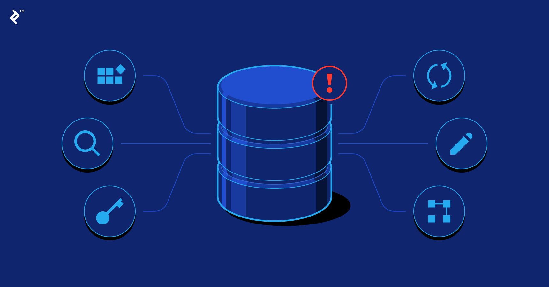

BANKING MANAGEMENT SYSTEM
PRESENTED BY:
QAZI SHARJEEL(BSE-23F-112)
ABDUL WASAY(SFS-23F-001)
AJLAL KHAN(BSE-23F-148)
ZEESHAN(BSE-23F-130)
PRESENTED TO:
MISS AQSA UMER

Slide 2

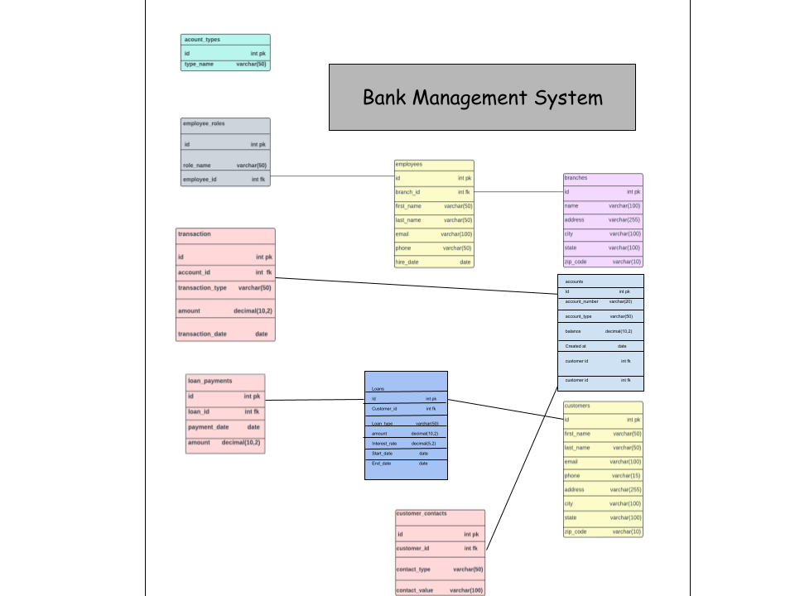
ER MODEL

Slide 3
CONTRIBUTION
MYSQL QURIES : QAZI SHARJEEL ,ABDUL WASAY, AJLAL KHAN, ZEESHAN
PPT : ABDUL WASAY
ER MODEL : QAZI SHARJEEL ,ABDUL WASAY

Slide 4
We Group members after doing long discussion end up with Banking Management System which includes following table :
1.Customers
2.Accounts
3.Transactions
4.Loans
5.Branches
6.Customer Contact
7.Account Type
8.Loan Payment
9.Employees
10.Emplotees Role

Slide 5

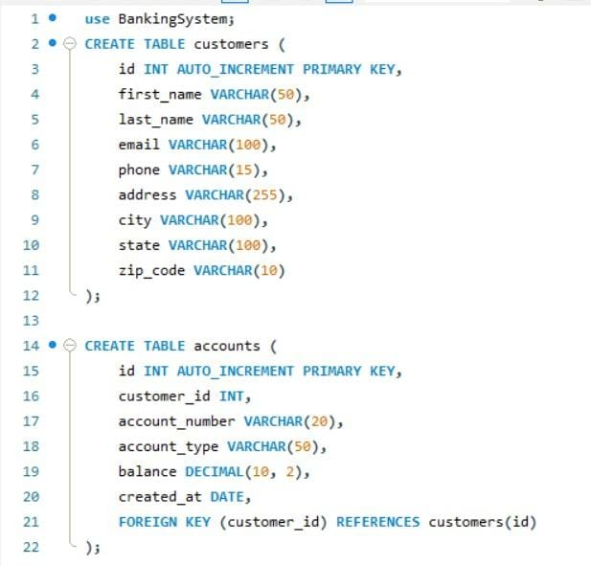
TABLES:

Slide 6
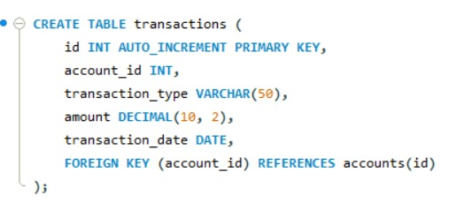
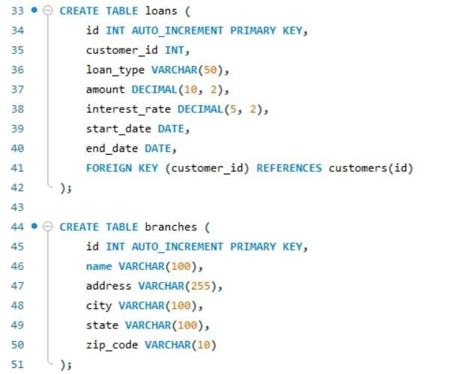

Slide 7
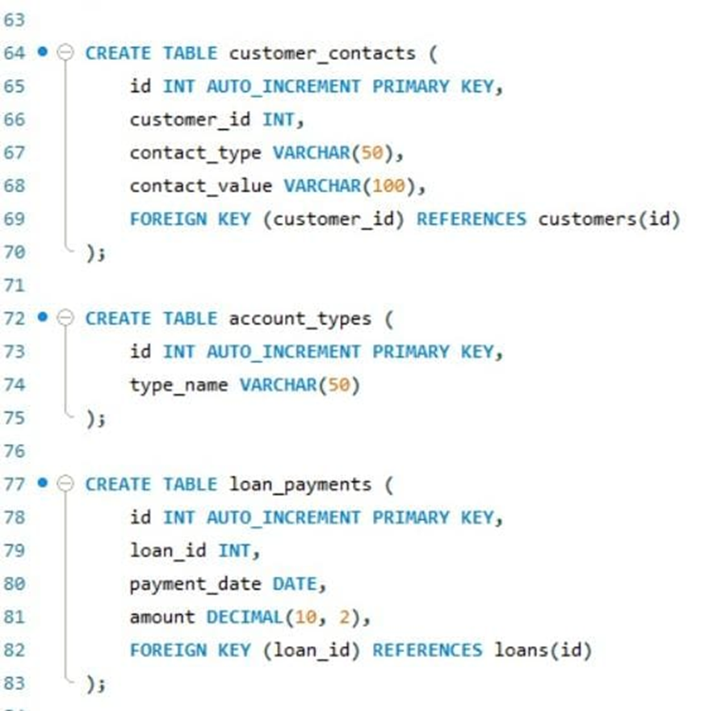

Slide 8
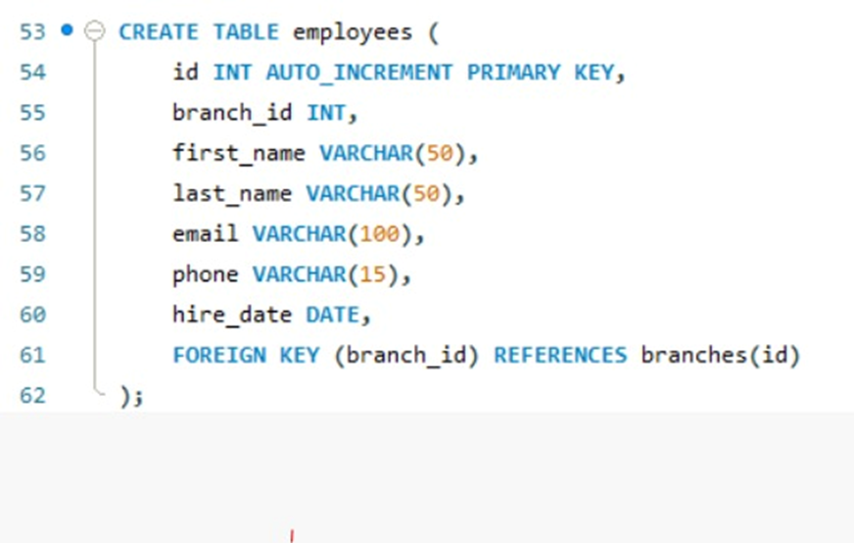
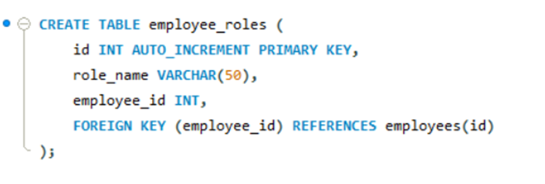

Slide 9
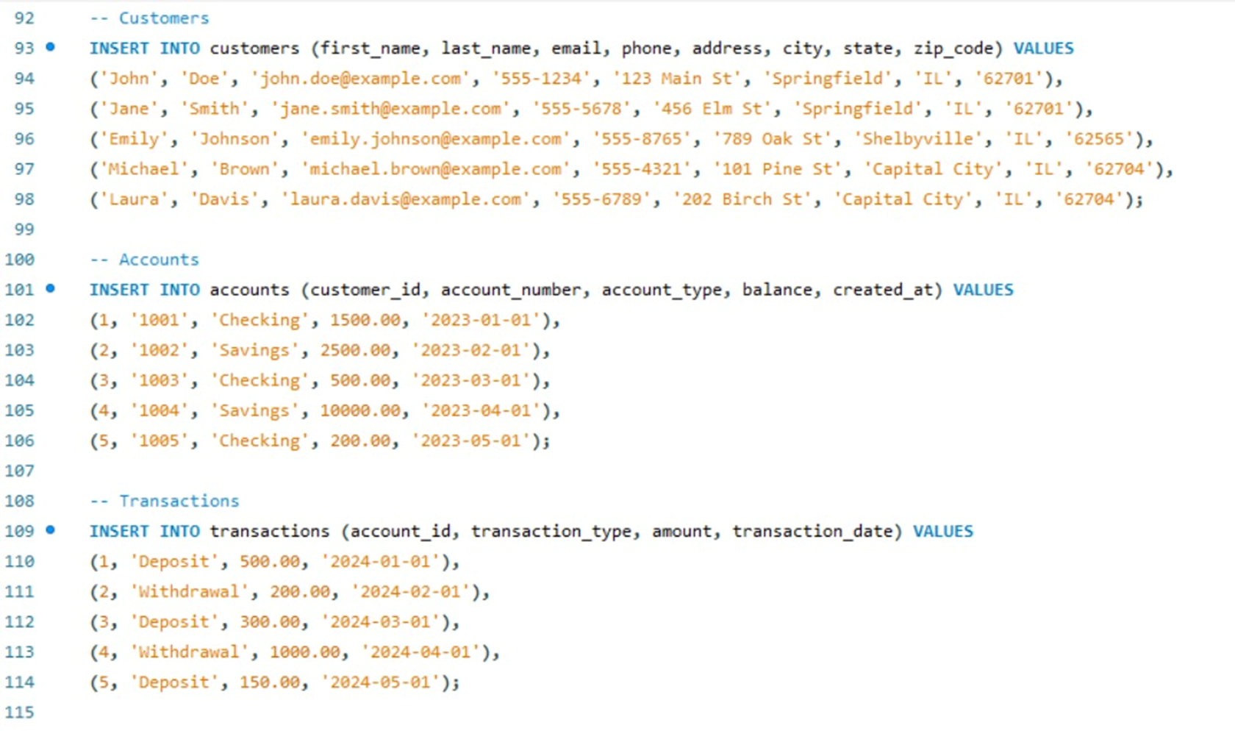
INSERTION OF DATA IN TABLES:

Slide 10
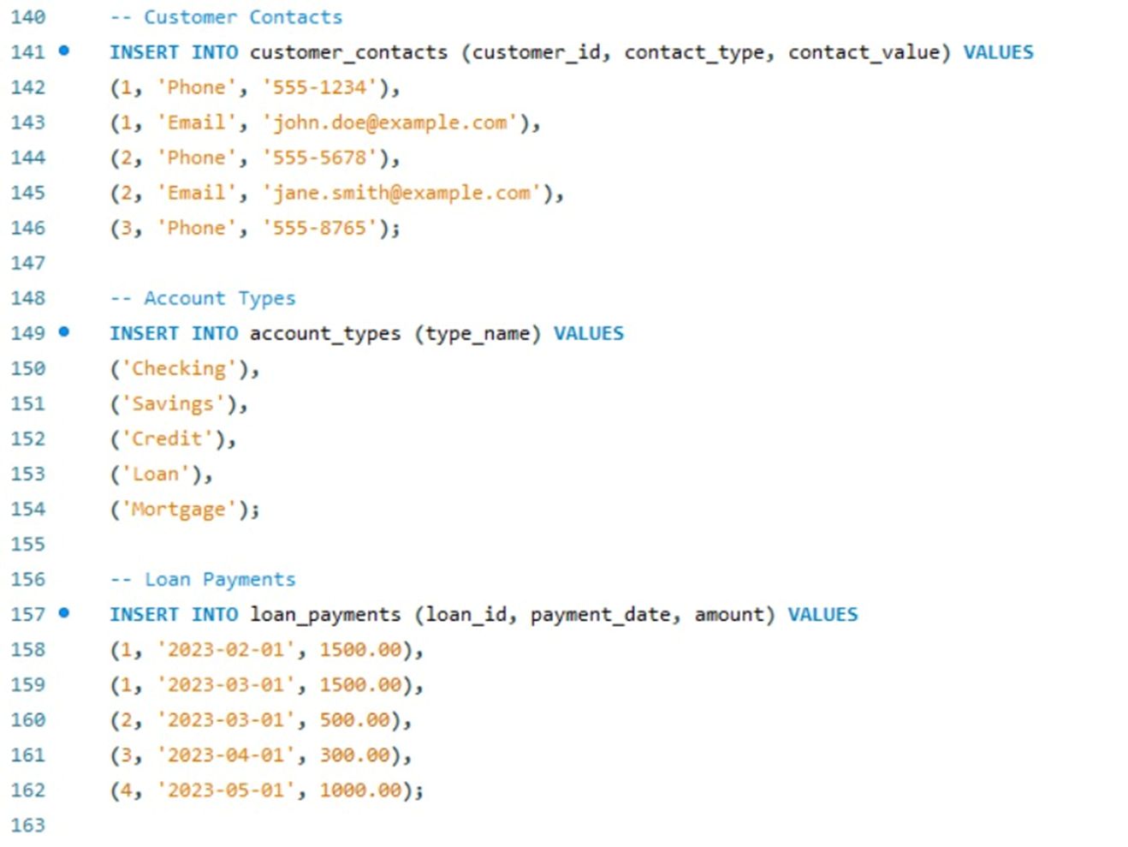

Slide 11
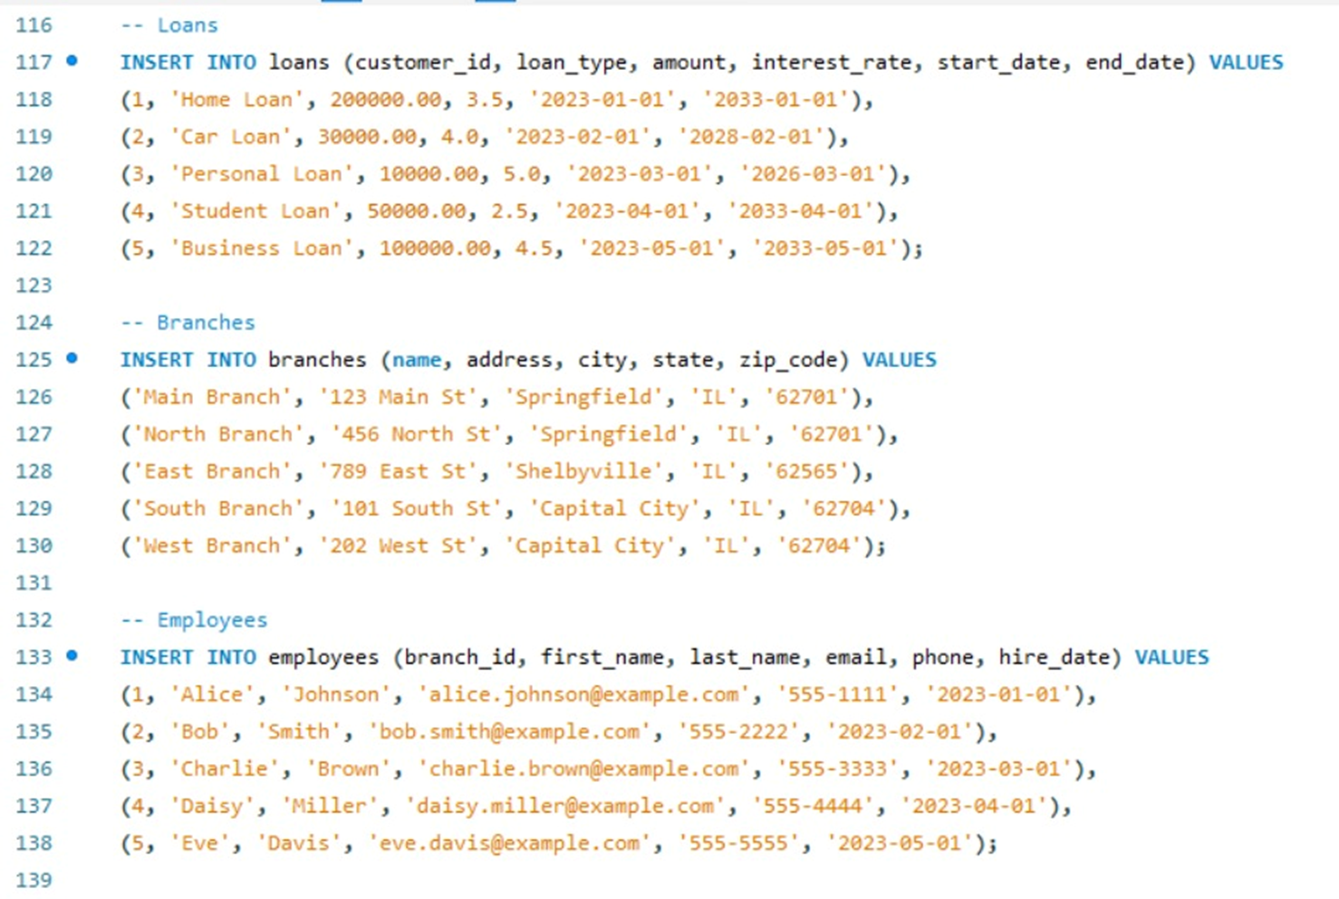

Slide 12
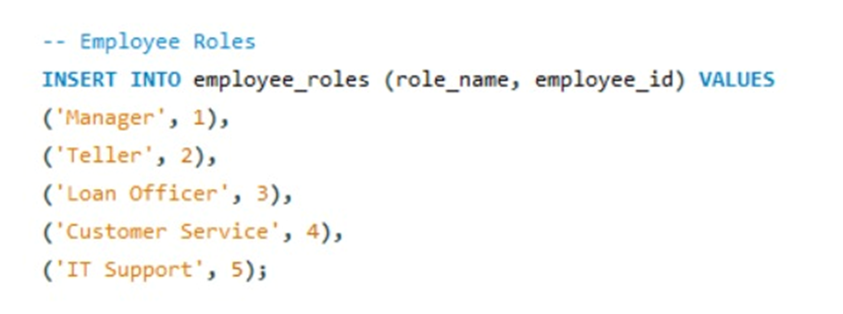

Slide 13
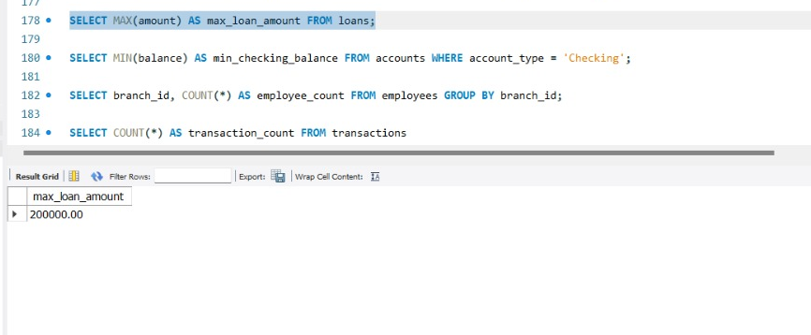
OUTPUT
So, here is the 1st query output, this query is an aggregate query which use to find out the max values.

Slide 14
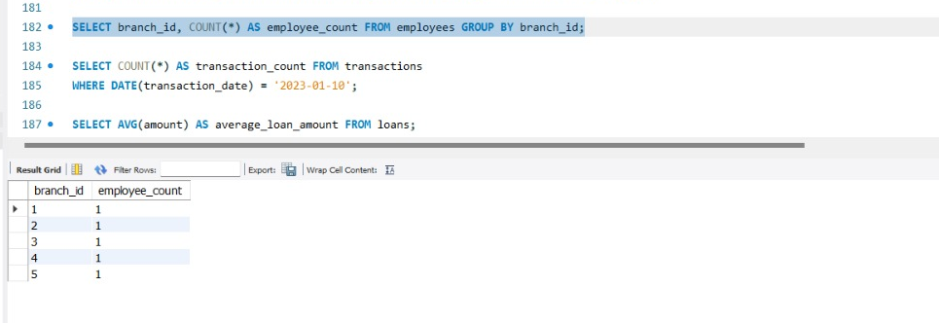
Here is the 2nd query output this query is an aggregate function which use for counting.

Slide 15
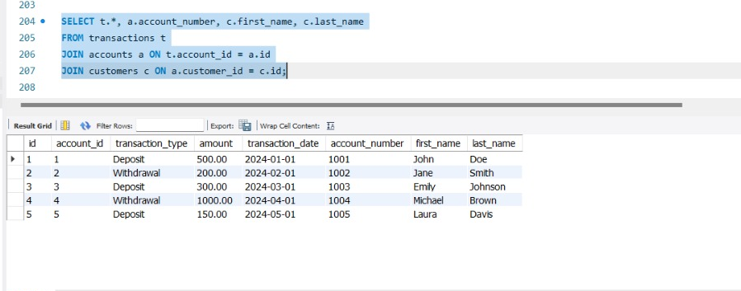
And the 3rd one in which we used join query this query is use to combine rows from 2 or more tables based on a related column between them.
As we can see on above.

Slide 16
THANK YOU

